Slide 1


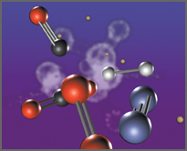
Advanced Graph Algorithms II
Strongly Connected Components, Bi-Connectivity, Max Flow
Advanced Graph Algorithms
SoftUni Team
Technical Trainers
Software University
http://softuni.bg

Slide 2
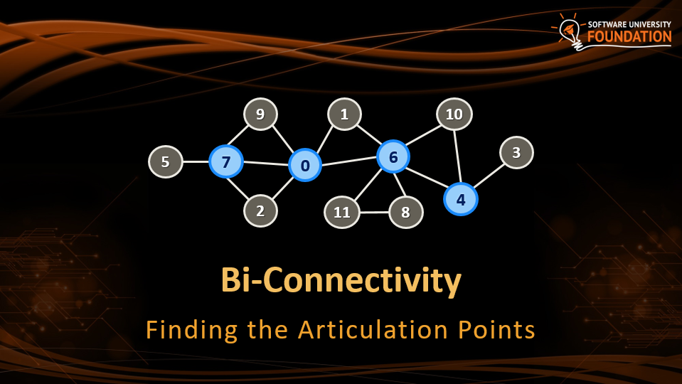
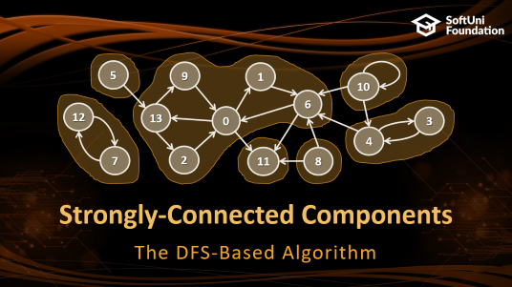
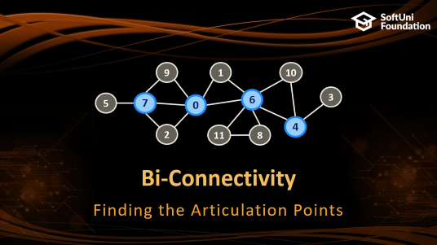
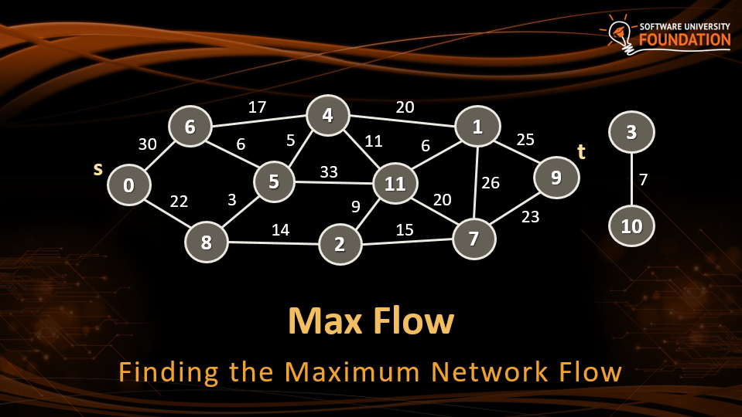
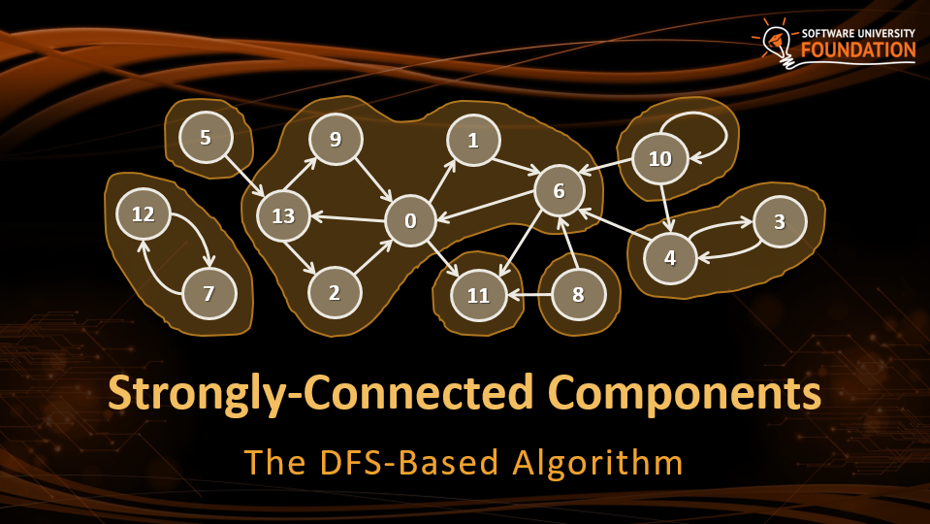
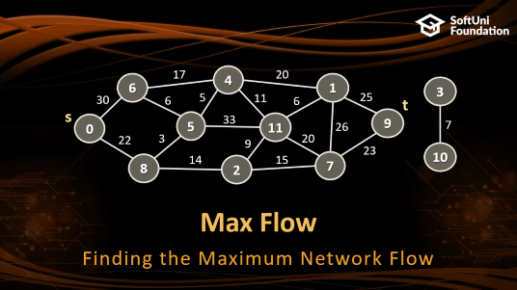
Table of Contents

Slide 3
Have a Question?
sli.do #DsAlgo

Slide 4
Strongly-Connected Components
5
9
1
10
6
12
13
0
3
4
7
2
11
8
The DFS-Based Algorithm

Slide 5
Strongly-Connected Components
A directed graph is strongly-connected
When every two vertices are connected by path
Example of strongly-connected graph:
9
1
10
6
7
0
3
4
2
5
8

Slide 6
Strongly-Connected Components
Strongly-connected component is a maximal strongly-connected subgraph (component with paths between any two nodes)
A directed graph can be decomposed into strongly-connected components, e.g.
5
9
1
10
6
12
13
0
3
4
7
2
11
8

Slide 7
Kosaraju–Sharir Algorithm
Let G be a directed graph and S be an empty stack
For each vertex v in G
Call DFS(v) to traverse the graph (visit each node once)
Each time DFS(v) finishes (before recursive return), push v onto S
Build the reverse graph G' (reverse all edges from G)
While S is non-empty:
Pop the top vertex v from S
if v is not visited, call ReverseDFS(v) to find the next strongly-connected component

Slide 8
Kosaraju–Sharir Algorithm
5
9
1
10
6
12
13
0
3
4
7
2
11
8
Lab

Slide 9
Bi-Connectivity
9
1
10
6
3
5
7
0
4
2
11
8
Finding the Articulation Points

Slide 10
Articulation Points
In a connected undirected graph an articulation point is a node that when removed, splits the graph into several components
The blue nodes below are the articulation points: 7, 0, 6, 4
There are 6 bi-connected components:
{5, 7}, {0, 2, 7, 9}, {1, 0, 6}, {6, 8, 11}, {4, 6, 10}, {3, 4}
9
1
10
6
3
5
7
0
4
2
11
8

Slide 11
Articulation Points – The Slow Algorithm
The straightforward algorithm – O(n * (m + n))
Remove each node and check whether the graph stays connected
Check for graph connectivity by DFS traversal + counting the number of visited nodes
foreach v ∈ graph nodes
temporary remove v
check for connectivity with DFS(u), where u ≠ v
if the graph is not connected, print v
restore v back in the graph

Slide 12
Articulation Points – The Fast Algorithm
The fast (linear) algorithm for finding articulation points is based on DFS traversal with some computations (Hopcroft, Tarjan, 1973)
Run a DFS while maintaining the following information:
The depth(v) of each vertex in the DFS tree (once it gets visited)
For each vertex v, the lowest depth of neighbors of all descendants of v in the DFS tree, called the lowpoint(v)
A non-root vertex v is an articulation point if there is a child y of v such that lowpoint(y) ≥ depth(v)
The root vertex is an articulation point if it has at least two children

Slide 13
Articulation Points – Fast Algorithm
FindArticulationPoints(node, d)
visited[node] = true
depth[node] = d
lowpoint[node] = d
childCount = 0
isArticulation = false
for each childNode in childNodes[node]
if not visited[childNode]
parent[childNode] = node
FindArticulationPoints(childNode, d + 1)
childCount = childCount + 1
if lowpoint[childNode] >= depth[node]
isArticulation = true
lowpoint[node] = Min(lowpoint[node], lowpoint[childNode])
else if childNode <> parent[node]
lowpoint[node] = Min(lowpoint[node], depth[childNode])
if (parent[node]<>null and isArticulation) or (parent[node]==null and childCount > 1)
print node as articulation point
Time complexity: O(N + M)

Slide 14
Finding the Articulation Points
9
1
10
6
3
5
7
0
4
2
11
8
Lab

Slide 15
Max Flow
17
4
20
6
1
3
30
6
5
11
6
25
t
s
33
9
0
5
11
26
7
22
3
9
20
23
10
8
14
2
15
7
Finding the Maximum Network Flow

Slide 16
Max Flow Problem
Weighted directed / undirected graph
With capacities assigned to the edges c(u → v)
Goal: compute the maximum flow from node s to node t
Each edge {u → v} holds certain flow flow(u → v)
flow(u → v) ≤ c(u → v)
For each node input flow == output flow
Max flow == sum(flow(s → v)) == sum(flow(u → t))
Total output flow from s == total input from to t

Slide 17
Ford-Fulkerson Max-Flow Algorithm
Ford-Fulkerson can be summarized in the following steps:
Start from zero flow: flow(u → v) = 0 for each edge
While possible:
Find augmenting path p such that
p is a valid path from s to t and for each edge {u → v} ∈ p → c(u → v) > 0
The flow(p) for the augmenting path p in s → t is the minimum capacity c of each edge {u → v} in the path s → t
Modify the capacities of the edges in the path p:
For each edge {u → v} ∈ p → c(u → v) = c(u → v) - flow(p)
For each edge {u → v} ∈ p → c(v → u) = c(v → u) + flow(p)
Add flow(p) to the maximum flow

Slide 18
Edmonds-Karp Max Flow Algorithm
If we use Breadth-first Search to Find the augmenting path we get the Edmonds-Karp algorithm
Start from zero flow: flow(u → v) = 0 for each edge
While possible:
Find an augmenting path p from s to t using BFS such that:
For each {u → v} ∈ p → c(u → v) > 0
Keep track of the parent for each visited vertex
Reconstruct the path p using the parents
Set flow(p) as the smallest capacity c in the path p
Modify the capacities of the edges in the path p as in Ford-Fulkerson:
Add flow(p) to the maximum flow

Slide 19
Edmonds-Karp – Step #1
Start from empty flows through all edges
Find an augmenting path: 0 → 6 → 4 → 1 → 9 (increment = 17)
Time complexity: O(VE²)
0/17
4
0/20
6
1
0/30
0/6
0/5
0/11
0/6
0/25
t
s
0/33
9
0
5
11
0/26
0/22
0/3
0/20
0/9
0/15
0/23
8
0/14
2
7

Slide 20
Edmonds-Karp – Step #2
Augment the flow through the path: 0 → 6 → 4 → 1 → 9 (increment = 17)
Current max flow = 17
17/17
4
17/20
6
1
17/30
0/6
0/5
0/11
0/6
17/25
t
s
0/33
9
0
5
11
0/26
0/22
0/3
0/20
0/9
0/15
0/23
8
0/14
2
7

Slide 21
Edmonds-Karp – Step #3
Find an augmenting path: 0 → 6 → 5 → 4 → 1 → 9 (increment = 3)
17/17
4
17/20
6
1
17/30
0/6
0/5
0/11
0/6
17/25
t
s
0/33
9
0
5
11
0/26
0/22
0/3
0/20
0/9
0/15
0/23
8
0/14
2
7

Slide 22
Edmonds-Karp – Step #4
Augment the flow through the path: 0 → 6 → 5 → 4 → 1 → 9 (increment = 3)
Current max flow = 20
17/17
4
20/20
6
1
20/30
3/6
3/5
0/11
0/6
20/25
t
s
0/33
9
0
5
11
0/26
0/22
0/3
0/20
0/9
0/15
0/23
8
0/14
2
7

Slide 23
Edmonds-Karp Algorithm
17/17
4
20/20
6
1
20/30
3/6
3/5
0/11
0/6
20/25
t
s
0/33
9
0
5
11
0/26
0/22
0/3
0/20
0/9
0/15
0/23
8
0/14
2
7
Lab

Slide 24
Terminology
Level Graph G_{L} :
A tree built by using BFS from the source s
Each node in the tree is assigned a value representing its distance from the start
The distance is the number of edges from the source s
Blocking flow:
Combination of all augmenting paths that can be built on G_{L}
Since G_{L} is created using BFS, any path p from s → t is going to have the least amount of edges possible

Slide 25
Dinic/Dinitz Max-Flow Algorithm
Dinitz can be summarized in the following steps:
Start from zero max flow: m = 0
Construct the level Graph G_{L} using BFS
If t is unreachable in G_{L} → return the max flow m
Find blocking flow f in G_{L} using DFS
Add flow f to the max flow m

Slide 26
Dinitz Algorithm Pseudocode – 1/3
private static int[] childCounter; // Track blocked edges
private static int[] bfsDist; // Distances in the Level Graph
private static List<int>[] edges; // adjacency list
private static int[][] capacities;
private static int endNode;
static int Dinic(int source, int destination)
{
int result = 0;
while (Bfs(source, destination)) // While we can find a path from source to sink
{
for (int i = 0; i < childCounter.Length; i++)
{
childCounter[i] = 0; // Reset blocked edges on each Level Graph
}
int delta;
do
{
delta = Dfs(source, int.MaxValue); // Each delta is the flow from an augmenting path
result += delta;
}
while (delta != 0);
}
return result;
}
Time complexity: O(V²E)

Slide 27
Dinitz Algorithm Pseudocode – 2/3
static bool Bfs(int src, int dest)
{
for (int i = 0; i < bfsDist.Length; i++)
{
bfsDist[i] = -1; // Reset distances in Level Graph
}
bfsDist[src] = 0;
Queue<int> queue = new Queue<int>();
queue.Enqueue(src);
while (queue.Count > 0)
{
int currentNode = queue.Dequeue();
for (int i = 0; i < edges[currentNode].Count; i++)
{
int child = edges[currentNode][i];
if (bfsDist[child] < 0 && capacities[currentNode][child] > 0) // If node has not been visited
{
bfsDist[child] = bfsDist[currentNode] + 1;
queue.Enqueue(child);
}
}
}
return bfsDist[dest] >= 0; // If there is a path to the sink return true
}
Time complexity: O(V²E)

Slide 28
Dinitz Algorithm Pseudocode – 3/3
static int Dfs(int source, int flow)
{
if (source == endNode) // If we reach the sink return the flow
{
return flow;
}
for (int i = childCounter[source]; i < edges[source].Count; i++, childCounter[source]++)
{
int child = edges[source][i];
if (capacities[source][child] <= 0) continue; // If the edge has no more room skip
if (bfsDist[child] == bfsDist[source] + 1) // Only check vertexes following the Level Graph
{
int augmentationPathFlow = Dfs(child, Math.Min(flow, capacities[source][child]));
if (augmentationPathFlow > 0)
{
capacities[source][child] -= augmentationPathFlow; // Fix capacities
capacities[child][source] += augmentationPathFlow;
return augmentationPathFlow;
}
}
}
return 0; // If no path is found return 0 – path is blocked
}
Time complexity: O(V²E)

Slide 29

Summary
Strongly-connected components
Use DFS + reverse DFS algorithm
Articulation points → use modified DFS
Maximum flow:
Ford-Fulkerson
Edmonds-Karp
Dinitz

Slide 30







Advanced Graph Algorithms II
https://softuni.bg/opencourses/algorithms

Slide 31
License
This course (slides, examples, labs, videos, homework, etc.) is licensed under the "Creative Commons Attribution-NonCommercial-ShareAlike 4.0 International" license
Attribution: this work may contain portions from
"Fundamentals of Computer Programming with C#" book by Svetlin Nakov & Co. under CC-BY-SA license
"Data Structures and Algorithms" course by Telerik Academy under CC-BY-NC-SA license

Slide 32





Trainings @ Software University (SoftUni)
Software University – High-Quality Education, Profession and Job for Software Developers
softuni.bg
Software University Foundation
http://softuni.foundation/
Software University @ Facebook
facebook.com/SoftwareUniversity
Software University Forums
forum.softuni.bg

